Slide 1
The Slashdot Zoo: Mining a Social Network with Negative Edges
Preliminary Presentation (Based on the existing paper)
Siva Satvik | - CS15BTECH11023
Goutham Meka | - CS15BTECH11025
Bhanu Prakash | - CS15BTECH11037
Vishwak Srinivasan | - CS15BTECH11043

Slide 2
Paper Deconstruction

Slide 3
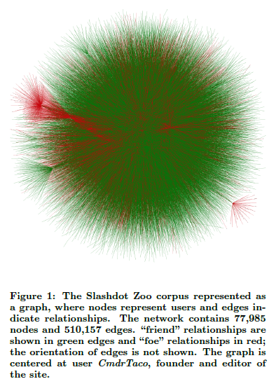
What is Slashdot (Zoo)?
Slashdot (founded in 1997) is a social news website which features news stories on science, technology and politics.
The Slashdot Zoo feature (added on 2002) allowed Slashdot users to tag other users are friends or foes.
The Slashdot Zoo corpus is as a graph dataset containing 77,985 users (as nodes) and 510,157 relationships (as edges).

Slide 4
Introduction
Social network analysis’ are usually based on positive edge weight values. We attempt to analyse inherently negative relationships (distrust and dislike) with negative edge weights.
To prove our assumption of multiplicative transitivity. Reflected by the statement, “the enemy of my enemy is my friend”.

Slide 5
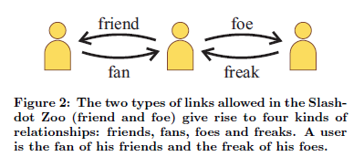
The Slashdot Zoo Corpus
The Slashdot Zoo corpus we consider in this paper contains 77,985 users and 510,157 links (endorsements).
Endorsements can be either positive (“friend") or negative (“foe").
A user is always the “fan” of his friends and the “freak” of his foes.
Slashdot generally limits the number of friends and foes to 200 users and to 400 users for subscribers. (Anomalies exist in the dataset)
The Slashdot Community is known for both having popular and rather unpopular users (trolls).

Slide 6

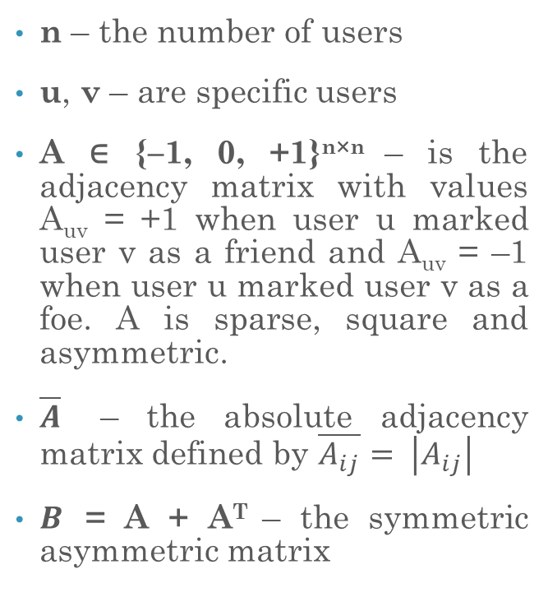
Definitions
n – the number of users
u, v – are specific users
A ∈ {–1, 0, +1}^{n×n} – is the adjacency matrix with values A_{uv} = +1 when user u marked user v as a friend and A_{uv} = –1 when user u marked user v as a foe. A is sparse, square and asymmetric.
$\overline{A}$ – the absolute adjacency matrix defined by $\overline{A_{ij}}= \left|A_{ij}\right|$
$B$ = A + A^{T} – the symmetric asymmetric matrix
$\overline{B}$ = $\overline{A}$+ $\overline{AT}$ – the absolute symmetric asymmetric matrix
$\overline{D}$ – the absolute diagonal degree matrix defined by $\overline{Dii}$ = $\sum_{j}{\left|A_{ij}\right| }$
$\overline{E}$ – the absolute symmetric diagonal degree matrix defined by $\overline{Eii}$ = $\sum_{j}{\left|B_{ij}\right| }$

Slide 7
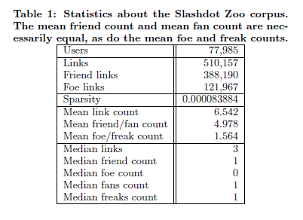
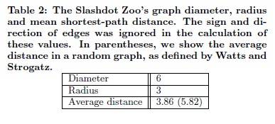
Corpus Statistics

Slide 8
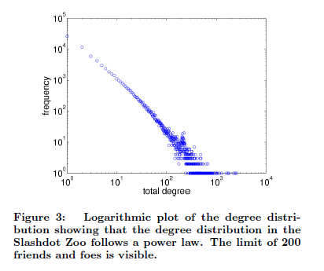
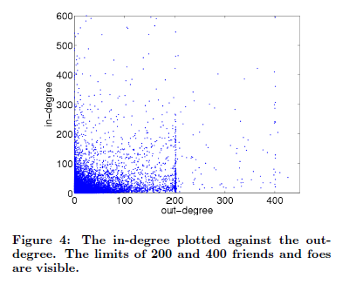
Corpus Statistics (Cont.)

Slide 9
Clustering Coefficient
To test the hypothesis of multiplicative transitivity, we study the whole network to see the extent of applicability of the multiplication rule.
We bring the concept of signed clustering coefficient, and relative clustering coefficient to see if our multiplicative transitivity assumption is justified.
Multiplicative Transitivity: A signed network exhibits multiplicative transitivity when any two incident edges tend to be completed by a third edge having as a weight the product of the two edges’ weights.

Slide 10
Popularity & Centrality
This part of the analysis helps us understand nodes that are central to the graph.
Various Popularity & Centrality Measures:
Fans Minus Freaks (FMF)
PageRank (PR)
Signed Spectral Ranking (SR)
Signed Symmetric Spectral Ranking (SSR)
Negative Rank (NR)

Slide 11
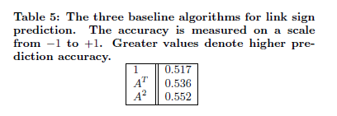
Link Prediction
We focus on prediction of the sign of the edges between two nodes, given that is the most relevant information.
Baseline Algorithms: The following three baseline algorithms are tested.
(1) – Always predict a positive edge.
(A^{T}) – If there is an edge in the opp. direction, predict the sign of the edge. Else, a positive edge.
(A²) - Use the squared adjacency matrix for prediction. Makes use of the multiplicative transitivity logic.

Slide 12
Link Prediction: Algebraic Similarity Measures
Corpus size makes A² and A³ computationally expensive. Thereby, we look at alternative algebraic similarity measures.
Dimensionality Reduction (A): The matrix A can be reduced dimensionally by performing a sparse singular value decomposition, resulting in a low-rank approximation of the original matrix:
Symmetric Dimensionality Reduction (A sym): We apply dimensionality reduction to the symmetric matrix A+AT . In the case of symmetric matrices, we use the eigenvalue decomposition:

Slide 13
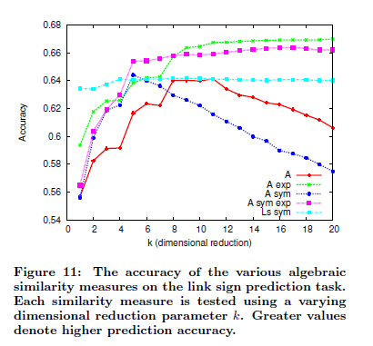
Link Prediction: Algebraic Similarity Measures Graph

Slide 14
Link Prediction: Experimental Evaluation
We split the edges into a training set (70%) and testing set (30%).
Accuracy is predicted based on matching parity.
A thorough study was performed on multiple kernels based on the this accuracy score and the best kernel was reported.

Slide 15
Conclusion
Our analysis on social network graphs with negative weights is broken down to three levels:
On the global level, we defined the signed clustering coefficient and the relative signed clustering coefficient.
On the node level, we defined Negative Rank. A new popularity measure that can identify trolls.
On the link level, using various signed spectral similarity measures, we studied for the task of link sign prediction. This could be useful in implementation as troll detection.
We concluded that the network exhibits multiplicative transitivity, as described by “the enemy of my enemy is my friend”.
We showed that these methods for analyzing a network bring out results that common, unsigned techniques can’t.

Slide 16
Prospective Approach

Slide 17
Tentative Plan
Hope to complete coding the paper and get results by a couple of weeks.
We are thinking about extending the work to incorporate more social network analysis methods spanning various centrality measures and not just PageRank.
We could also propose a more robust kernel for the sake of prediction.

Slide 18
Thank you.

